Slide 1
Sri Lanka Institute of Advanced Technological Education [S L I A T E]
INDIVIDUAL PROJECT
Proposal-2024
Food inventory management system
H.P.D. dilshan kumara.
TAN/IT/2023/F/0062

Slide 2
Slide arrangement
What is the meaning of food inventory management?
What is the Background?
Problems?
The aim?
Objectives?
have System Analysis?
Functional requirement
Non-functional requirement
Resource requirement
Software's
Mark up languages
Frameworks
Programming languages
Time of project?
References?

Slide 3
What is the meaning of food inventory management?
A manual food inventory system tracks food items using physical records like spreadsheets or notebooks. It requires manually updating stock levels, expiration dates, and usage.

Slide 4
What is the Background?
A manual food inventory system has been used for years to manage stock by recording details on paper or in spreadsheets. It relies on manual entry and regular updates to track food items, their quantities, and expiration dates. While less efficient compared to automated systems, it offers simplicity and low cost. It’s commonly used in smaller operations or where technology adoption is limited. Accurate record-keeping and routine audits are essential for effective management.

Slide 5
Problems?
A manual food inventory system often struggles with inaccuracies due to human error in data entry and updates. Tracking and managing inventory can be time-consuming and labor-intensive. It may also lead to stock discrepancies if records are not frequently updated or audited. This system lacks real-time data, making it difficult to respond quickly to inventory issues. Additionally, it can be challenging to analyze trends or generate reports efficiently.

Slide 6
The aim?
food inventory system is to accurately track and manage food.

Slide 7
Objectives?
Accurately Track Stock
Prevent Overstocking
Avoid Shortages
Manage Expirations
Organize Records

Slide 8
have System Analysis ?
This system have a,
01)Use case diagram
02)ER diagram
03)Class diagram

Slide 9
Functional requirement
Search potions
User controller
E-mailing
User mart
User cart
Purchasing

Slide 10
Non-functional requirement
High user experience
Reliability
Ease of Use
Material User interface…

Slide 11
Resource requirement
Hardware
Pc
Lap
Mobile phone…

Slide 12
Software's
Brackets
Web storm
PHP storm
Wamp server…

Slide 13
Mark up languages
CSS
HTML…

Slide 14
Frameworks
Bootstrap

Slide 15
Programming languages
JAVASCRIPT
PHP
JQUERY

Slide 16
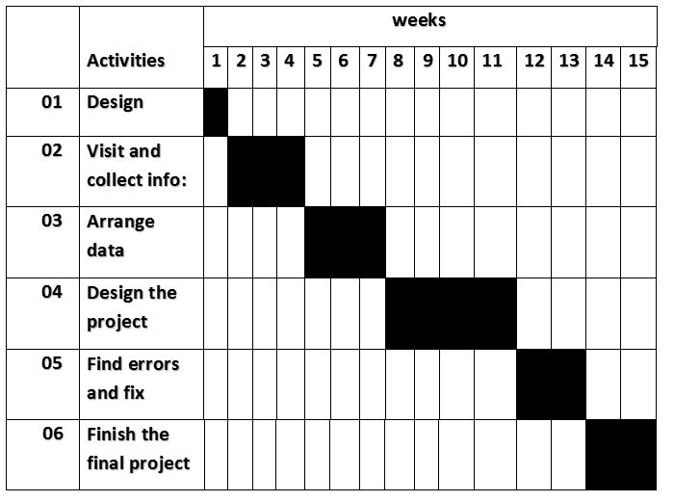
Time of project?

Slide 17
References?
classnet. inventory management. america, 2020.
<https://assets.ctfassets.net/hfb264dqso7g/3KMzofgMM9PAaDvXHTeLXJ/cf96f49029129793bd82811b43406ac7/inventory-management-pdf.pdf>.
fishbowl. what is inventory management? us:
https://youtu.be/sl5zEPRkp0U, 2004.
wikipidiya. inventory. 2008.
<https://en.wikipedia.org/wiki/Inventory>.
zebra. What Is Food Inventory Management? america, 2018.
<https://www.zebra.com/ap/en/resource-library/faq/what-is-food-inventory-management.html#:~:text=Food%20industry%20inventory%20management%20encompasses,receiving%20and%20storing%20of%20goods.>.

Slide 18
Thank you.

